Slide 1
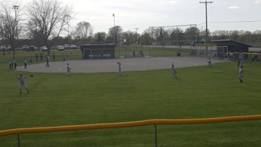
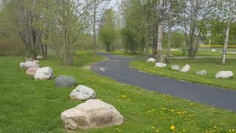
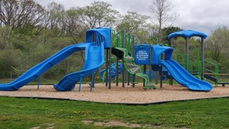


Charter Township of Union
Audit Results
PRESENTED BY
Ali N. Barnes
CPA, CGFM
Fiscal Year Ended
December 31, 2022

Slide 2
Audit Opinion
Unmodified Opinion
  Highest level of assurance
  The financial records and statements are fairly and appropriately presented, and in accordance with accounting principles generally accepted in the United States of America; this includes the design, implementation, and maintenance of internal control relevant to the preparation and fair presentation of financial statements that are free from material misstatement, whether due to fraud or error.

Slide 3
General Fund Revenues

Slide 4
General Fund Expenditures

Slide 5
General Fund – Fund Balance

Slide 6
Fire Fund

Slide 7
Water Fund

Slide 8
Sewer Fund

Slide 9
Internal Controls and Compliance
Material Weakness
  American Rescue Plan Act Fund
    Actual expenditures in excess of approved budget by $56,119
No Significant Deficiencies
No Written Management Comments

Slide 10

Let’s thrive.
Through our family of companies, we work with you to achieve your unique goals.
VISIT
yeoandyeo.com
CALL
800.968.0010
EMAIL
ali.barnes@yeoandyeo.com
CONNECT

