Slide 1
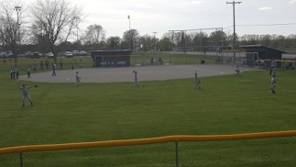
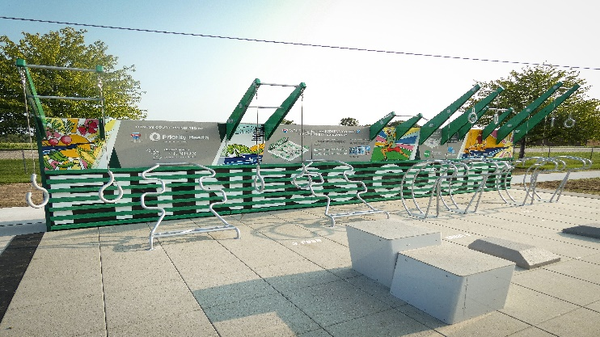
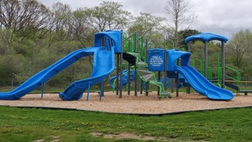


Charter Township of Union
Audit Results
PRESENTED BY
Ali N. Barnes
CPA, CGFM
Fiscal Year Ended
December 31, 2023

Slide 2
Audit Opinion
The purpose of an audit
Unmodified opinion
  Highest level of assurance
Management’s responsibility
  Preparation and fair presentation in accordance with GAAP
  Design, implementation and maintenance of internal controls
Auditors’ responsibility
  Express opinions on the financial statements based on our audit

Slide 3
General Fund Revenues
Notes:
2020/2021/2022 – These fiscal years included contributions from either the Tribe or one of the DDA’s for projects. No such contributions recorded in General Fund in FY 2023.
2023 – Increase in building permits.
2023 – Increase in investment income.

Slide 4
General Fund Expenditures

Slide 5
General Fund – Fund Balance
Total Fund Balance
Total Fund Balance to Total Expenditures

Slide 6
Fire Fund

Slide 7
Water Fund
Total Revenues and Expenses
Working Capital

Slide 8
Sewer Fund
Total Revenues and Expenses
Working Capital

Slide 9
Internal Controls and Compliance
Material Weakness
  Recording of Mission Creek Drain
No Significant Deficiencies
Management Comments
  Review of journal entries

Slide 10
Let’s thrive.
Through our family of companies, we work with you to achieve your unique goals.
VISIT
yeoandyeo.com
CALL
800.968.0010
EMAIL
ali.barnes@yeoandyeo.com

